Slide 1
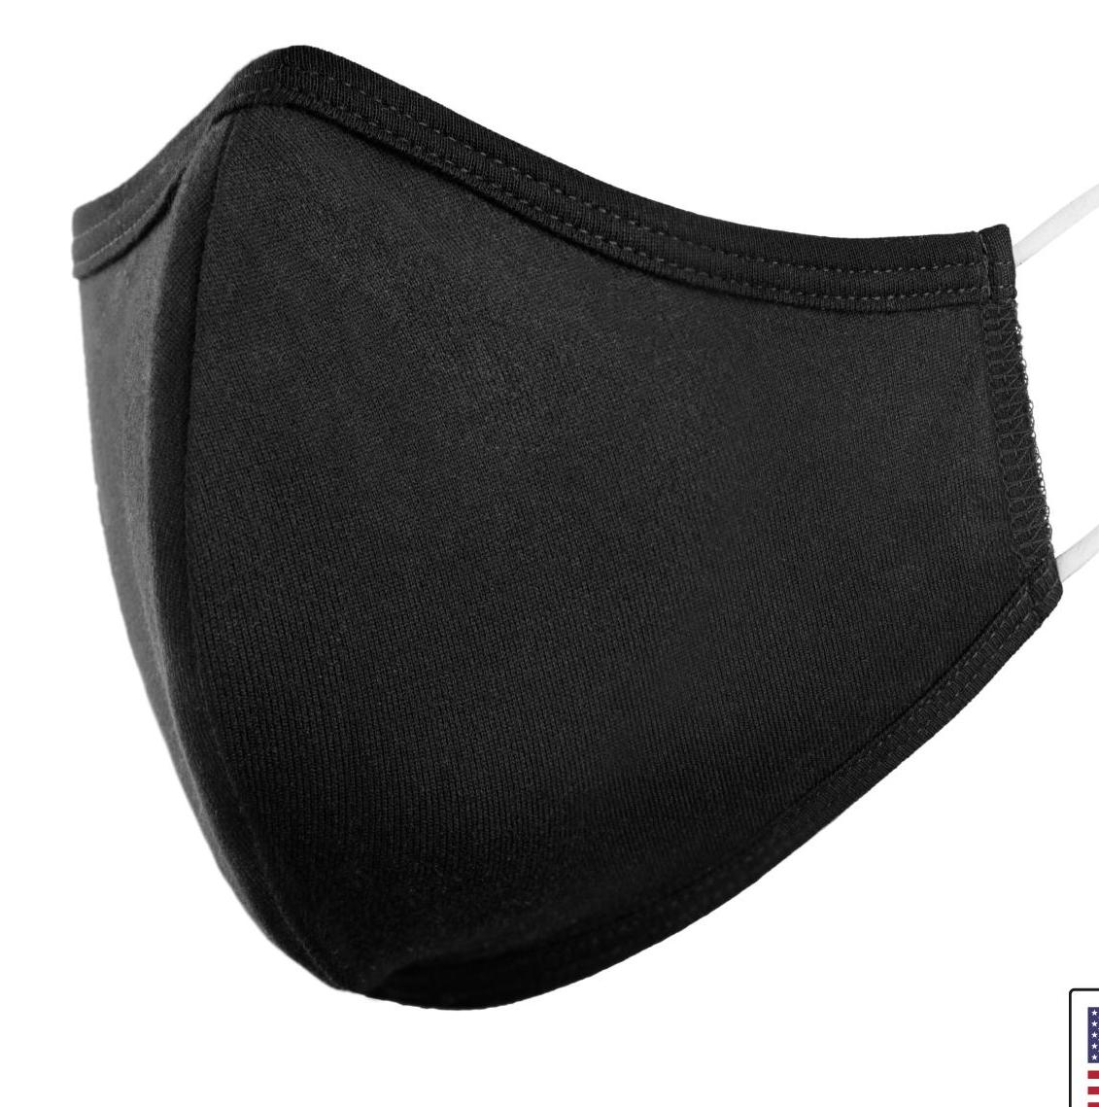

Two Umpire Mechanics – Plate ump in the Field
This
BU
Not this
PU

Slide 2
Priorities
1. Balls/strikes
2. Fair/foul, no plays if foul. *
3. Safe/outs
4. Other: tag ups, missed bases, interference/obstruction, etc.
*if no clue on fair/foul down 3b line rule “Foul,” both teams now have chance to make a play.

Slide 3
Basic Principles of the Two-man System Two Umpires in the Field
If you go to the plate, stay. Other ump has all 3 bases.
2. PU takes all plays at hp that play starts from infield, BU must be ready for play at 1b.
3. Overthrows: if ball is on 3b side PU takes ball. If ball on 1b side BU takes ball.
4. Line drives, catch/no catch: 3b side PU, 1b side glove coming at you.
5. Check swing: ask, sometimes better angle from 1b even with LHH. Barrel ahead of hands.
6. Batter interference/obstruction: PU primary, BU secondary
7. Balks, no stop: RHP,PU; LHP, BU; other ump will be screened out by pitcher’s body. Other balks both umps.

Slide 4
Basic Principles Plate Umpire
1. Work as deep as what makes you comfortable in the “C” position.
2. Has all plays at 2B and 3B .
3. Has all plays at 1B if partner goes out.
4. Has plays at the plate that originate from the infield and possible second plays in the infield.
5. Has Fair/Foul, Catch/No Catch on balls hit on 3B line. Try to get to the line on fly balls and take your best shot on bouncing balls/line drives over the bag.
6. Between innings, position yourself on the 3B line, near the plate. Count the warmup throws and alert both the catcher and batter on last pitch. Brush plate off, remind catcher to help clean the plate if needed with no plays at the plate, then return to “C” position.
6. Baseballs will be supplied by home team and umpire will wear ball bag and supply balls to the pitcher

Slide 5
Basic Principles Base Umpire
1. Position in regular “A” position with no one on.
2. With runner on 1B, angle for pick-off, like 3-Man.
3. Responsible for all initial plays at 1B. Come into the field as you normally would.
4. Rotates to plate anytime a runner is heading to 3B; it doesn’t matter where the runner originated from and on tag-ups of fly balls to the OF with Runner on 3B. Before returning to “A” position, brush off plate.
5. Responsible for pick-offs at 1B.
6. Responsible for trouble fly balls to Center fielder (in and back) and towards the RF line.
7. If you go out, try to return to the plate for a possible play.(communicate with partner)
8. Responsible for swipe tags and pulled foot on plays at 1B as well as running lane violations.

Slide 6
Basic Principles Both Umpires
1. Balks
2. Foul balls in batter’s box
3. Catcher’s obstruction
4. Batter Interference
5. Hit by pitch
6. Carry a plate brush (not for the pitcher’s plate)

Slide 7
Starting Positions
PU
Left foot on edge of dirt
½ way between mound and second
Infield in, move in (maintain 6’)
PU
BU
BU
8-10’ behind first baseman
Right foot an inch off the line
Step toward plate on delivery
For Pick-off
8-10’ behind first baseman
1” off the line
Body at 45 degrees
Hands on thighs

Slide 8
No Runners
Fly ball coverage
Fair/Foul
BU
Center fielder in and out on catch. If you go out, try to get back to the plate for a possible play on dropped ball or hit. Foul ground straight back behind the plate and down 1B side.
RF line on fair/foul.
PU
BU
PU
A. All catches 3B side to Center fielder also foul area from catcher to 3B side. On routine fly bally, you have eh big”V.” Anytime your partner goes out, you have all plays on the baes until he tells you he’ll be at plate for you.
B. 3B line. If not sure, rule foul. This way each team will still have a chance to make a play

Slide 9
No Runners
Base hit, ground ball with play at 1B, Fly ball to outfield
Double
Triple
Home run
BU
Take play at 1st.
Watch BR touch 1B and drift to foul ground behind 1B in case you have to cover the plate.
Watch BR touch 1B and go to foul ground and cover the plate.
D. Watch BR touch 1B and cover the plate for touch.
PU
BU
PU
A. Watch for swipe tag/pulled foot
B & C. Stay in “C” position working area, adjust for play at 2B or 3B.
D. Note: anytime your partner goes out, you have all plays until he tells you he’ll be at plate for you.

Slide 10
Runner on 1st
Ground ball in infield
Fly Ball to outfield
Base hit
Double
Triple
Home run
BU
A. Get set for double play, if ball gets by 2B-watch touch at 1B and head to plate.
B. Get angle for Catch/Tag
C. Watch BR touch 1B, get to foul ground for possible rotation to plate.
D. E. F. Watch BR touch 1B, get to plate.
PU
BU
PU
A. Has play at 2B
B. Has possible Catch/ No catch/ touch at 1B (if partner goes out) get ready for play at 2B or 3B on dropped ball.
C. Has any play at 2B or 3B.
D. Has any play at 2B or 3B or possible throw back to 1B (with partner covering the plate).
E & F. Has all touches at 2B and 3B.

Slide 11
Runner on 2nd
BU
A. Be ready for play at 1B and if overthrow at 3B, pivot and take BR into 2B.
B. Watch touch at 1B in case of dropped ball and head to plate for possible play.
C. Head to plate for possible play and watch touch at 1st B
Ground ball
Fly ball
Base hit
BU
PU
PU
A. Has play at 3B or throw back to 2B, if overthrow to 3B, cover plate.
B. Line up catch/tag of 2B, take runner into 3B.
C. Watch touch of 3B and pick up BR
4

Slide 12
Runner on 3rd
BU
A. Take play at 1B,
B. Head to home while watching catch & tag at 1B, take play at plate on R3.
Also, let partner know if you have the tag up at third
C. Nothing
D. Watch play for possible dropped ball, if asked for help
Ground ball
Fly Ball
Steal
Wild pitch/passed ball
BU
PU
PU
A. Has play at plate.
B. Watch catch/tag at 3B.
C. Has steal of home.
D. Has both plays at the plate, move to third bas line for better angle
4

Slide 13
Runner on 1st & 3rd
BU
A. Take play at 1B, if no play, be ready to go to the plate if R1 heads to 3B.
B. Head to home while watching catch and tag at 1B, take play at plate on R3. Let partner know if you have tag up at third.
C. Head to plate for back end of double steal.
D. Head to the plate, watch tag at 1B.
Ground ball
Fly Ball
Base hit
Steal
PU
BU
PU
A. Has play at plate or at 2B if double play is attempted. Remember touch at plate also on DP.
B. Watch catch/tag at 3B and take runner from 1B into 2B.
C. Has steal play at 2B.
D. Head to working area and read plays on R1 and BR, you have both.

Slide 14
Runner on 1st & 2nd
Ground ball
Base hit
Fly ball
Extra base hit
BU
A. Be ready for back end of double play and head home on a messed up play.
B. Head to plate while watching touch at 1B by BR.
C. Watch tag at 1B (line up to see catch and tag), then head to plate for a possible play.
D. Head to plate while watching touch of 1B by BR for possible play.
PU
BU
PU
A. Has 1st play at 3B or 2B.
B. Has touch at 3B and 2B, get to working area for possible plays at 3B or 2B.
C. Line-up Catch/ No Catch/Tag at 2B and responsible for play at 3B or 2B.
D. Responsible for all runners (plays and touches) at 2B and 3B.

Slide 15
Runner on 2nd & 3rd
Ground ball
Base hit
Fly ball
BU
A. Has play at 1B and if no play on BR, take BR into 2B if he goes.
B. Has play at 1B and if no play on BR, rotate to HP.
C. Head to plate for play on runner from 3B while watching touch at 1B. Also, let partner know if you can take tag up at third.
PU
BU
PU
A. Has play at plate and 3B.
B. Has touch at 3B and pick up BR into 2B or back to 1B.
C. Watch catch and tags at 3B and 2B, if caught, take runner from 2B into 3B.

Slide 16
Runner on 1st 2nd 3rd
Ground ball
Hit (any)
Fly Ball
BU
A. Be ready for play at 1B and take BR into 2B.
B. Head to home while watching catch and tag at 1B, take play at plate on R3.
C. Head to plate while watching touch at 1B.
PU
BU
PU
A. Has play at plate, 3B or 2B and touches at plate and 3B.
B. Has all plays and touches at 3B and 2B.
C. Has touches and plays at all bases if partner goes out.

Slide 17
Run-down between 1st and 2nd with runner on 1st or BR
PU
BU

Slide 18
Run-down between 2nd and 3rd
PU
BU
PU has it all

Slide 19
Run-down between 3rd and home
PU
PU has it all, until BU gets to HP
BU

Slide 20
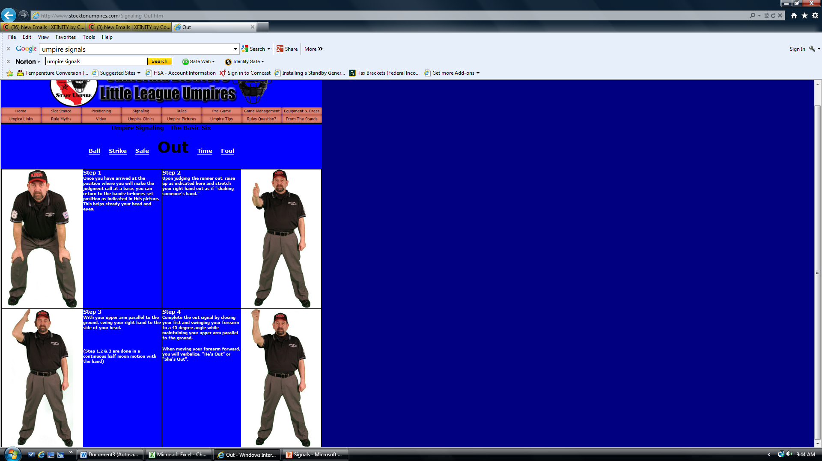
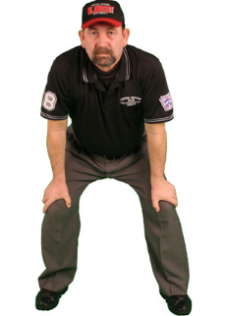
Ready Position
Strike signal

Slide 21
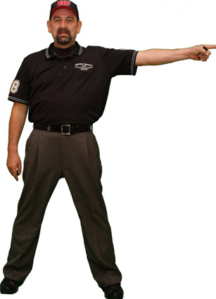
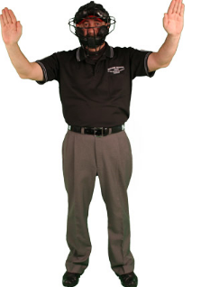
Foul Ball
Fair Ball

