Slide 1
Rotation … What is it?
It involves the plate umpire moving to cover third base to help base umpire
It may occur with a man on first only or man on first and third
The play at third is taken inside the diamond at the cut-out
If full rotation is not completed, 15 feet toward third and away from the foul line should be achieved

Slide 2
Rotation to Third
Move toward 3rd
Read if there is going to be a play
If Necessary move to cutout

Slide 3
Man on first base
Man on first and third base
New position for U1
Pick off: 2 step move

Slide 4
Rotation to Third
Move toward 3rd
Read if there is going to be a play
Glance for touch of home
If Necessary move to cutout

Slide 5
Obstruction
2008 change to Federation rules
The fielder without possession of the ball denies access to the base the runner is
attempting to achieve.
Rationale: Certain fielders are susceptible to blocking the base path of the runner. The
defense gains an advantage because the runner does not want to interfere or be ejected from the
game due to malicious contact. This rule provides positive benefits to both offensive and
defensive teams by minimizing risk

Slide 6
Obstruction OBR
2.00 Obstruction: Obstruction is the act of a fielder who, while not in possession of the ball and not in the act of fielding the ball, im
If a fielder is about to receive a thrown ball and if the ball is in flight directly toward and near enough to the fielder so he must occupy his position to receive the ball he may be considered "in the act of fielding a ball." It is entirely up to the judgment of the umpire as to whether a fielder is in the act of fielding a ball.
pedes the progress of any runner.

Slide 7
A ball throw at 75 MPH travels at 110 feet per second
A runner running at 25 MPH travels 36 feet per second
A ball thrown from right field at 140 from the plate takes 1.3 seconds to arrive
A ball throw from right filed takes .54 seconds to get from the mound to the plate

Slide 8
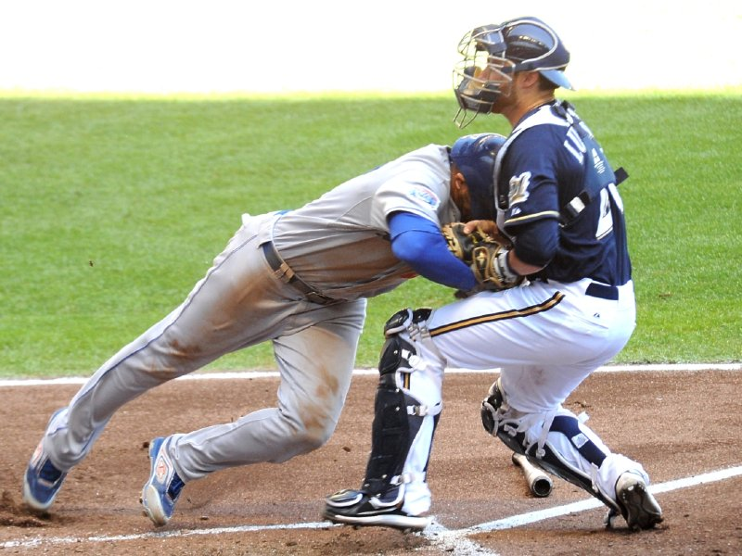
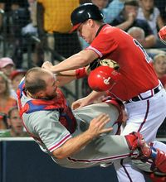
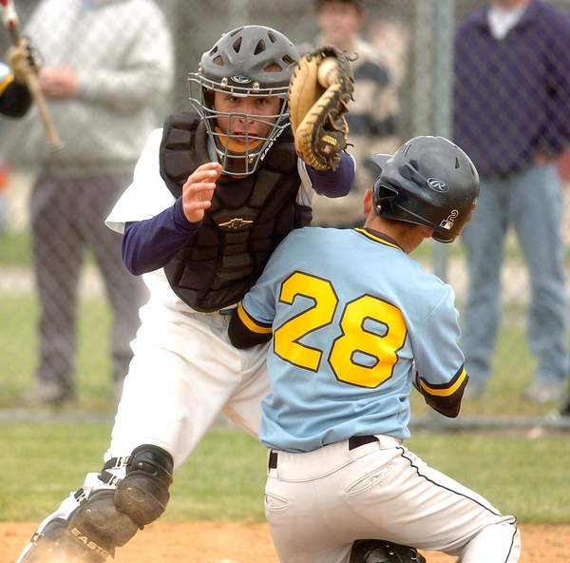
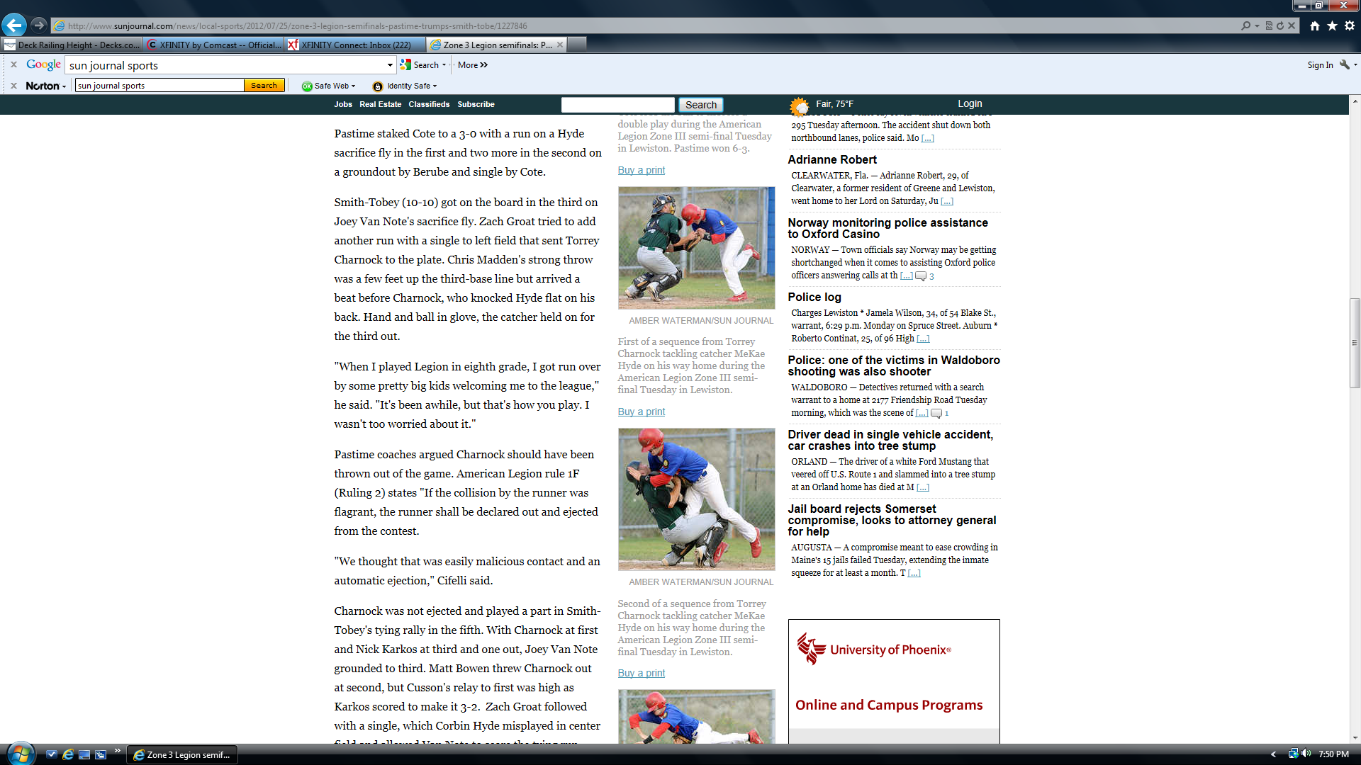

Slide 9
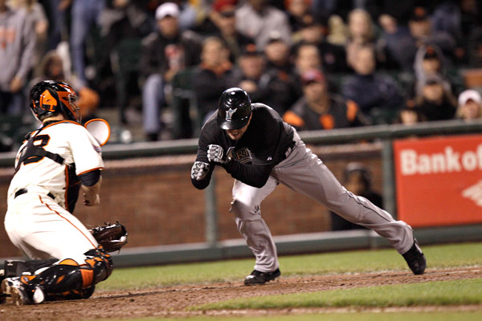
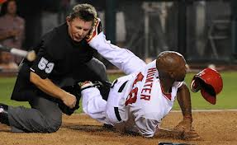
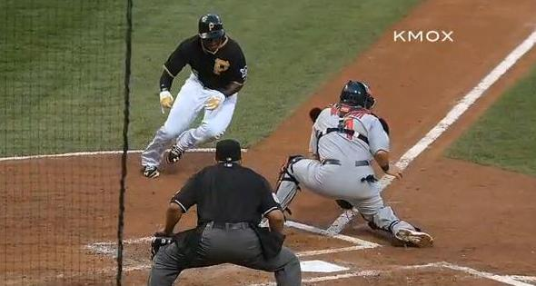
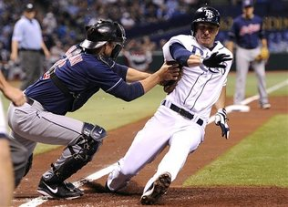

Slide 10
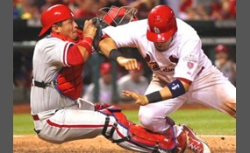
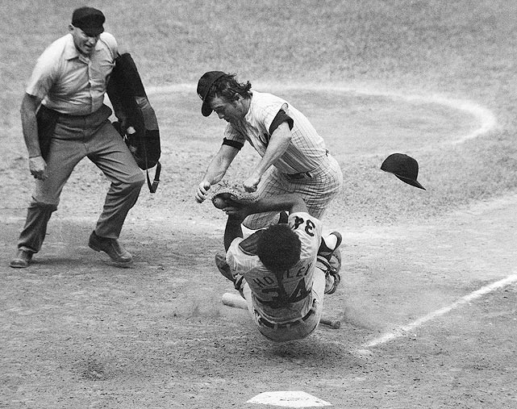

Slide 11
http://www.youtube.com/watch?feature=player_detailpage&v=S1d-C-zrmNU
http://www.youtube.com/watch?v=ltPWetfJS0c collision at plate
http://www.youtube.com/watch?v=ENcBAaeCXsk&NR=1&feature=fvwp professional ejection
http://www.youtube.com/watch?v=Y4nJqEsIrIM&NR=1&feature=endscreen position of PU
http://www.youtube.com/watch?v=Dp8ST0WidfA position of U1 on play at first

Slide 12
Notes from Clinics
Force play slide rule applies to all bases and HP
Right filed ground out, U1 read play
Position of PU on plays at the plate
PU watching ball on pop ups around the plate or behind
PU watching other action instead of the ball
PU giving fair/foul signals
Action by U1 in A on pop ups around first base
Position of U1 on plays to first base with pitcher covering
U1 in A covering catch/no catch
Saying more than needed at meeting with coaches

Slide 13
Tag Plays at Home
Where to be?
What to consider
  Where did hit ball go
  Is there time to change positions
  Do you have catch no catch responsibility
  Do you have fair foul responsibility
2. What to look for
  Catcher’s position
  Quality of throw to the plate
  Path the runner is taking
3. You will most likely have to take a step one way

