Slide 1
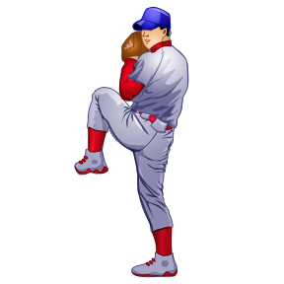
March 27, 2011 edited 3/9/14
Barry Fuller, interpreter CMBABU

Slide 2
“That’s a Balk”
What is a balk?
A balk is an illegal act committed by the pitcher with runner(s) on base which entitles each runner to advance one base
You can only have a balk if there is a least one runner on

Slide 3

Based on the pitching position, the illegal acts to that cause a balk differ
The position of the feet determine whether wind up or stretch

Slide 4
Balks from the wind up
Pick off attempt with out stepping off
Dropped ball ( and ball does not cross foul line)
Starting motion and then stopping or hesitating
Stepping off with non pivot foot
The position of the feet determine whether wind up or stretch
Illegal pitch
Pitching while not on rubber
Taking hand out of glove while on rubber

Slide 5
Balks from the stretch
Illegal pitch
Not on rubber
Start and stop
More than one stop
Stopping above head
Dropped ball
Not gaining ground, (length of foot)
Taking ball out of glove and not pitching or throwing or feinting
Taking signs off rubber
Feinting to first, turning shoulder toward first after coming set
Not stepping directly to base
Failing to pitch after non-pivot foot bases behind back edge of pitching plate
Being on or astride of within 5’ of the rubber without the ball when live
Taking hand off the ball after coming set and not pitching
Throwing to unoccupied base

Slide 6
Failing to pitch to the batter when the entire non-pivot foot passes behind the perpendicular plane of the back edge of the pitcher’s plate except when throwing or feinting to second base.
Must pitch
Pick off attempt would be a Balk

Slide 7


Slide 8
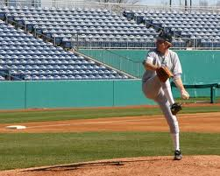

Slide 9

Step toward base 45⁰ angle

Slide 10
Righty
Wind up or stretch
Windup
Legal/illegal ?
Legal

Slide 11
Righty or Lefty
Wind up or stretch
Windup
Non-pivot foot shall be in any position on or behind a line extending through the front edge of the pitching plate.
Legal/illegal ?
Legal

Slide 12
Lefty
Wind up or stretch
Windup
Legal/illegal ?
Legal

Slide 13
Righty
Wind up or stretch
Stretch
Legal/illegal ?
illegal

Slide 14
Righty
Wind up or stretch
Implied Stretch
Legal/illegal ?
Parallel
illegal

Slide 15
Righty
Wind up or stretch
Windup
Legal/illegal ?
Legal

Slide 16
Lefty
Wind up or stretch
Windup
Legal/illegal ?
Legal

Slide 17
Righty
Wind up or stretch
Windup
Legal/illegal ?
illegal

Slide 18
Righty
Wind up or stretch
Stectch
Legal/illegal ?
Legal

Slide 19
Jump Turn
Failing to step toward (gain ground, guideline, one length of foot), don’t get too fine with this
Legal/illegal ?
illegal

Slide 20
Spin Move
Failing to step toward. This is an easy one, ball of non pivot just spins.
Legal/illegal ?
illegal

Slide 21
Who else can balk besides the pitcher?
Catcher
Not having both feet in box at time the pitch is released

Slide 22
http://www.youtube.com/watch?v=v4lnMmQz3yI&feature=related

Slide 24
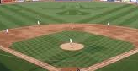
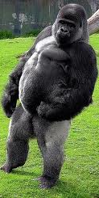

Slide 26
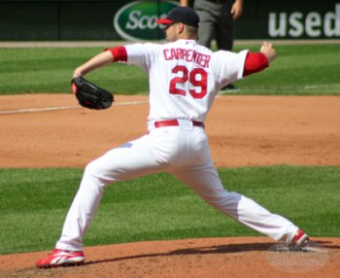
Neoprene sleeve must be covered with undershirt and meet same length requirement

