Slide 1



2025 S.M.U.A.
Interpreter’s clinic
Presented by Jeff Mertzel, State Interpreter
Presentation designed by Chris Barstow, SMUA Secretary/Treasurer

Slide 2
Clinic agenda
NFHS Rule Changes 2025
NFHS Points of Emphasis 2025
Maine Points of Emphasis
Questions & Other Areas For Discussion

Slide 3
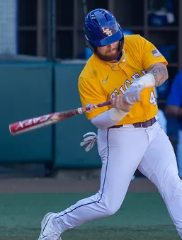
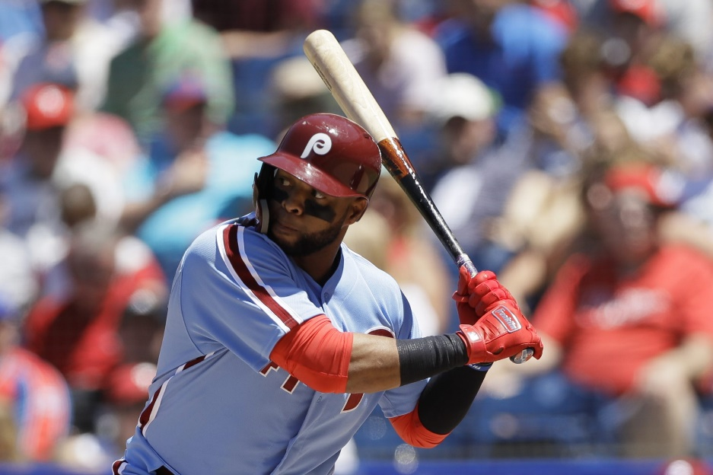
2025 Rules change – bats & drying agents
Modified that resin, pine tar or any other drying agent is permitted on the bat in a specific area (1-3-2c1) – This change allows the batter to have better control over their non-wood bat, so it does not slip out of their hands due to moisture or perspiration. It also makes the rule similar for wood bats and non-wood bats.

Slide 4
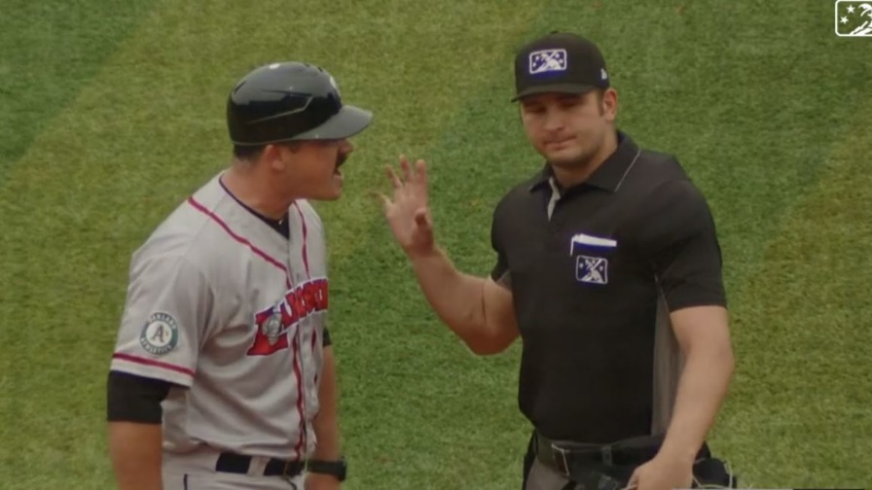
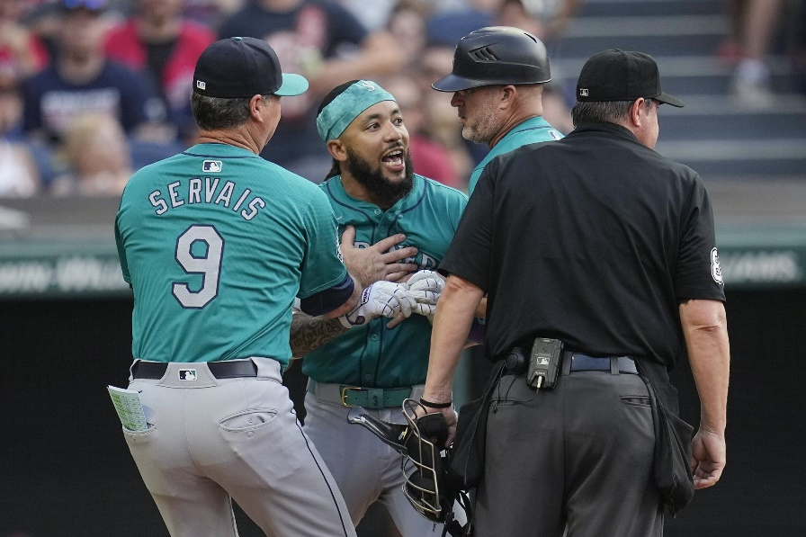
2025 Rules change – definition of forfeiture
Modified the definition of forfeiture (4-4-1c) – There are seven criteria for forfeiture. This modification of the subsection “c” is the result when a coach, player or team personnel does not conform to the instructions of the umpire. An ejection is a serious violation of sportsmanship and game decorum. To aggravate the violation with a game forfeiture is egregious and contrary to the basic premise of education-based athletics.

Slide 5

Points of emphasis –
Use of Authenticated Mark Program Balls
Applies to JV/frosh as well
What if?
The use of baseballs that have the Authenticated Mark printed on them proves that the conforming equipment is essential to the integrity of contests played under the NFHS rules. This program helps to promote a level playing field by ensuring consistency in the equipment being used. Using baseballs that hold the Authenticating Mark allows for the development of more sophisticated standards in balls and clearly communicates to administrators, coaches and officials that these standards are being met.
The MPA uses the Rawlings R100NF model for state and regional finals. Any brand can be purchased by schools, so long as they have the required NOCSAE/NFHS logos.

Slide 6
Points of emphasis –
Pitching positions
The premise of the pitching positions is very basic, it has evolved over the years to stay current with existing teaching styles and the increasing skill levels of high school age students. It is one of the most talked about and modified rules in the history of NFHS rules writing. We should always be cautious and concerned that the reasons to change the rule is never associated to the whims or trends of other levels of baseball.
Pitchers are required to use one of two positions: the wind-up or the set. It is important that umpires, coaches, and players know what position the pitcher is using so they know which part of Rule 6 is in play.
The position of the pivot foot determines which of the pitching positions is being used.
In the wind-up position, the pitcher’s pivot foot is in contact with the pitcher’s plate and is not parallel to it. They may only deliver a pitch or step backward off the pitcher’s plate with the pivot first.
In the set position, the pivot foot is in contact with or directly in front of and parallel to the pitcher’s plate.
And does not have to stop
And does have to stop

Slide 7
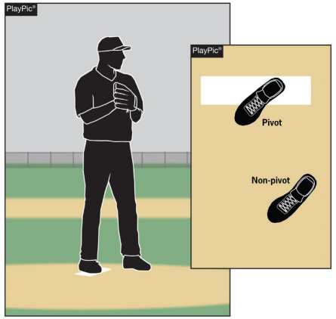
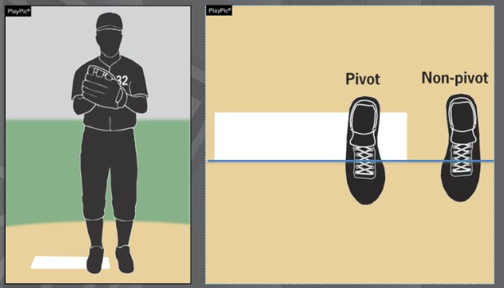
Legal windup position

Slide 8
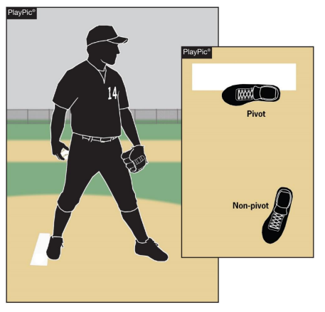
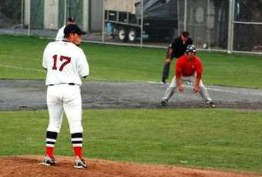
Legal set position

Slide 9
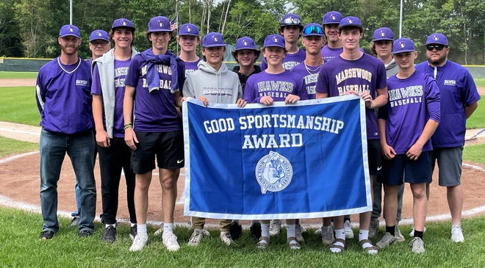
Points of emphasis – bench decorum
umpire classroom 2025 points 0:54-8:15
umpire classroom 2025 rule changes 1:09 -7:00
Sportsmanship, or good sporting behavior, is about treating one another with respect and exhibiting appropriate behavior. It is about being fair, honest and caring. When these types of appropriate behavior occur, competitive play is more enjoyable for everyone. Coaches set the tone at athletic contests with their display of sportsmanship and respect.
If these individuals act in a sportsmanlike manner, and they manage the students in their dugout/bench area, their behavior sets a positive tone for players, spectators and others.

Slide 10
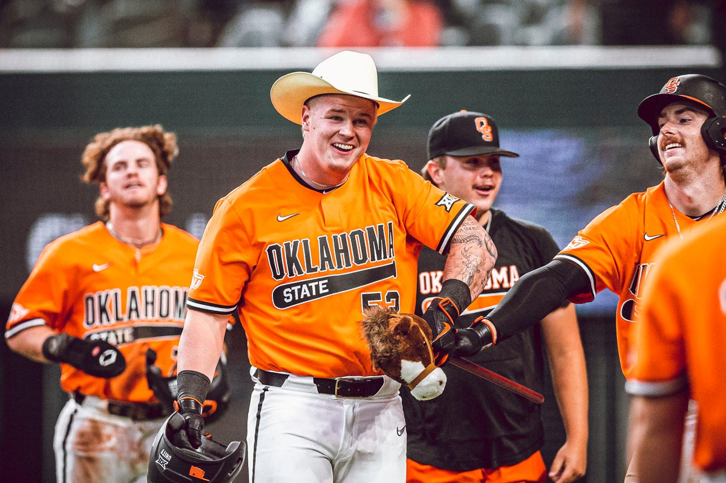
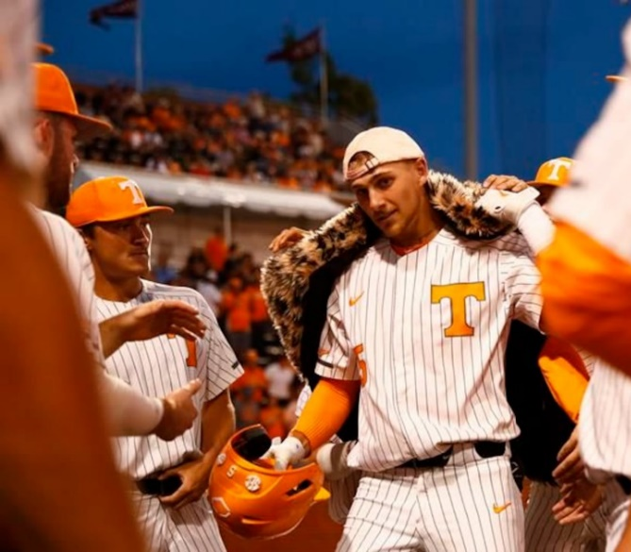
Points of emphasis – use of props
Like Bench Decorum, there is no logical purpose to have props at an education based athletic event. They are not enhancing the educational value of the contest. In fact, they deter from any valuable lesson gained from competing. Unlike the collegiate and professional models, the use of props or any items to demean or embarrass one’s opponent is contrary to the reason the NFHS writes playing rules for high school age and skilled students.
Game Management Guidelines
The Head Coach will be restricted to the dugout for the remainder of the game when a prop is brought onto the playing surface at any time. The Head Coach could be subject to further penalty if props continued to be brought onto the playing field. The use of props in the team’s dugout area is permissible.

Slide 11
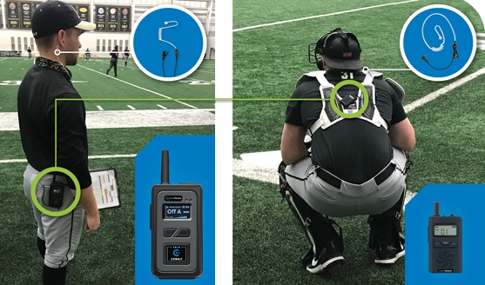
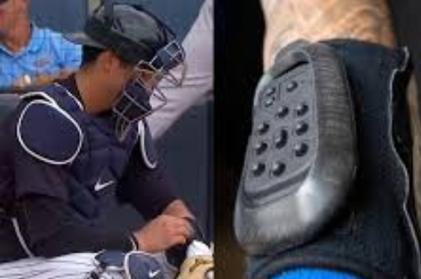
Points of emphasis – improper use of communication equipment
Last season was the first year of allowing one-way electronic communication devices from the dugout/bench to the catcher. It permits the coach to communicate with the catcher using an electronic communication device for the purpose of calling pitches and setting up the defense.
The device would only be able to be one-way, meaning the player cannot use an electronic device to respond or communicate back to the coach. Various technologies, ear-piece style, electronic band or a smart watch could be used giving schools several options at varying costs.
No other player would be able to wear or use this device nor would the coach be able to communicate with any other player using electronic communication.

Slide 12
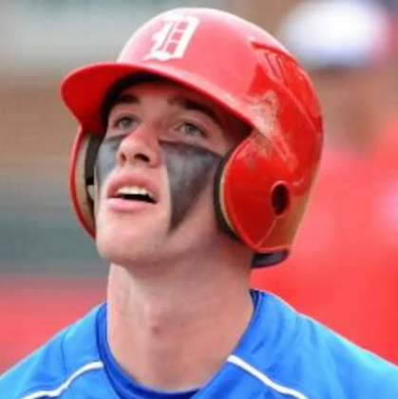
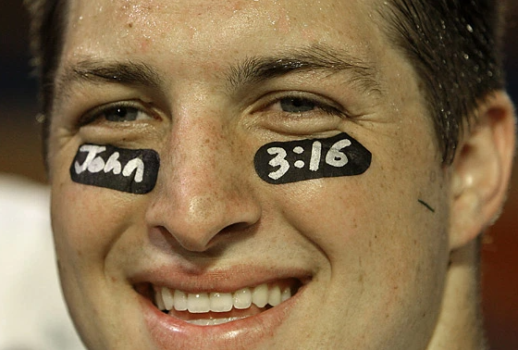
Maine points of emphasis – eye black usage
The grease version of eye black has been repeatedly used as a face decoration. Use of eye black is allowed, and may be applied using the following standards:
  Eye black should be one single line, to be applied under each eye.
  If using an adhesive strip, it shall not have any sayings or expressions written on the strip. This includes, for example, religious verses or a uniform number in honor of a teammate.

Slide 13
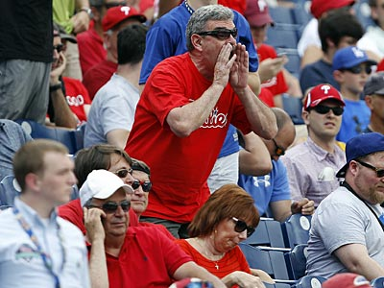
Maine points of emphasis -responsibilities for spectator conduct
Per NFHS Rule 10-2-3h — Umpires have jurisdiction over the confines of the field, players, coaches and team/bench personnel. If there are issues with spectators, it is the responsibility of game management to deal with spectators and to ensure that the facility is safe for all involved.
Game Management Protocols:
Any interactions between spectators and umpires should be limited and professional in nature. We want to have an appearance of approachability, while also maintaining focus on our game management responsibilities.
Umpires should never directly engage with spectators exhibiting inappropriate behavior.
Should spectators exhibit behavior that is inappropriate, the crew chief should request that the site supervisor/A.D. resolve the situation accordingly. If there is no site supervisor/A.D., the head coach is the site supervisor by default.
If the behavior continues, or the behavior is so adversely severe that it should result in immediate removal, the site supervisor/A.D. shall be instructed to have the spectator(s) removed.
  The game should be halted until the spectator(s) are removed and the situation resolved.
Following the conclusion of the game, a game report should be provided to your local board interpreter.

Slide 14
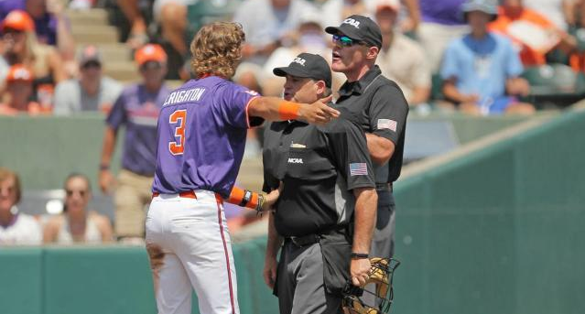
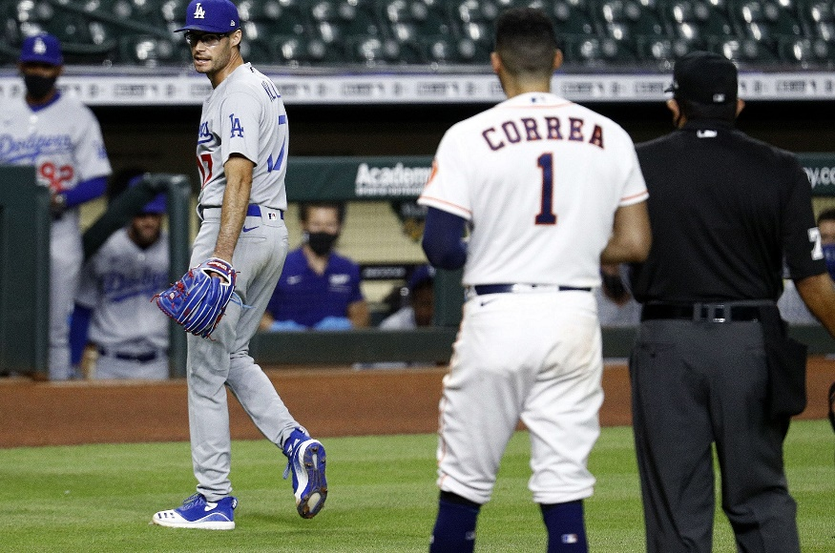
Maine points of emphasis – participant & Umpire behavior expectations
Umpires have a responsibility to conduct themselves in a balanced, professional manner. An official’s goal should be to administer the rules, manage the game and build relationships with participants that are positive and constructive.
Coaches have a responsibility to role model good sportsmanship, while maintaining control of their team personnel.
  If coaches do not uphold their responsibilities, use the “warn, restrict, eject” process for dealing with unsporting behavior.
  Team personnel, based on the severity of unsporting behavior, can also be restricted to the dugout or ejected.
Do not hesitate to provide official warnings for bench/team personnel behavior (bench jockeying or taunting).
If a coach or team personnel are ejected from a contest, a phone call and written game report should be provided to your local board interpreter.

Slide 15
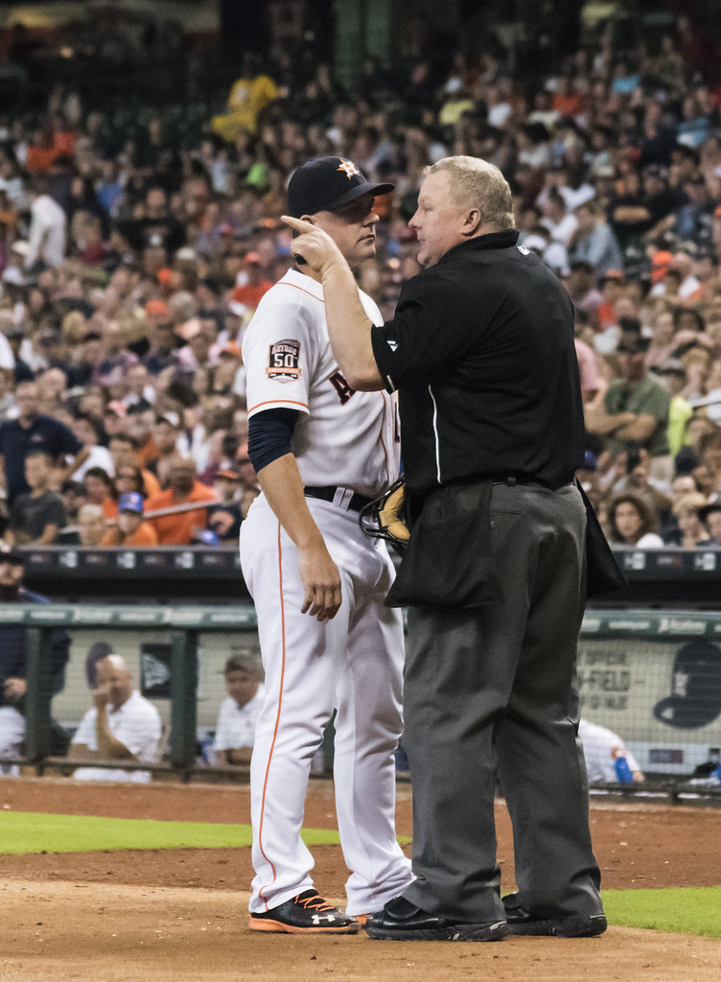
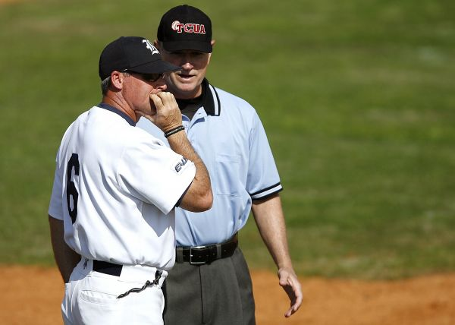
Coach’s visits to umpire
Once again all meeting with coach with base umpire will take place at the 45 foot mark on one of the foul lines
All meetings between coach and base umpire will take place at the 45-foot mark on one of the foul lines
This Photo by Unknown Author is licensed under CC BY-NC
All meetings between coach and plate umpire will take place near edge of dirt area baround the plate

Slide 16
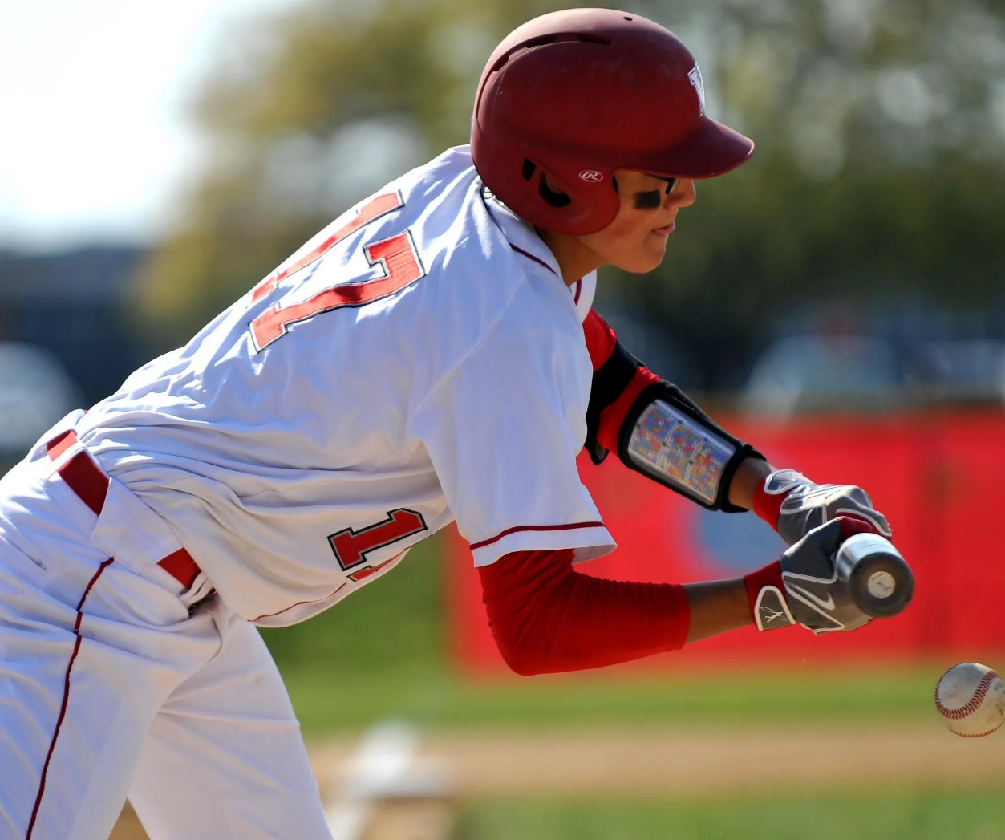
2024 Rules change – Wearing of wristbands
Clarified that wristbands that are non-electronic shall be worn on the wrist or forearm of a player and certain colors are restricted (1-6-1) — With the increase in popularity of these style of communication systems, confusion has occurred when the players wear them other than on their arm. This change will prohibit these types of products from being worn other places.

Slide 17
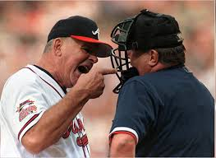
2024 Points of emphasis – profanity
Profanity (Direct or Indirect)
Education-based athletics is a direct extension of the classroom. When the educational component is removed, then everything changes, and it becomes a completely different game, devoid of accountability and structure. A student who blurts out a profanity either toward someone or simply out of frustration in school would be disciplined by the classroom teacher or the building principal. There is no excuse for foul language in school or on the baseball field. Regardless of what is portrayed at other levels, this is not acceptable and should be addressed by the umpire(s). The rule support for this behavior is clear, the penalties are: (1) a verbal warning to the offender, (2) issuance of a written warning to the offender which warrants being restricted to the bench/dugout for the remainder of the game, or (3) eject the offender for a major offense. The Bench and Field Conduct Section (NFHS Rule 3-3-1f1-4) provides several sub-articles addressing profanity and harmful behaviors. High school sports and other activities exist to lift people up, positively challenge them and their abilities, not to demean or tear people down. The goal is to treat everyone fairly and treat each other with respect. Any language that is profane, intimidating, insulting, demeaning or hurtful will not be tolerated. Coaches, school administrators and parent groups should work together to ensure that the game creates a positive environment for all involved. Profanity spoken loud enough to be heard is profanity that needs to be dealt with immediately.

